Slide 1
MVC Model
Enterprise web application development CS383

Slide 2
Web application architecture
Web application architecture defines the interactions between applications, middleware systems and databases to ensure multiple applications can work together

Slide 3
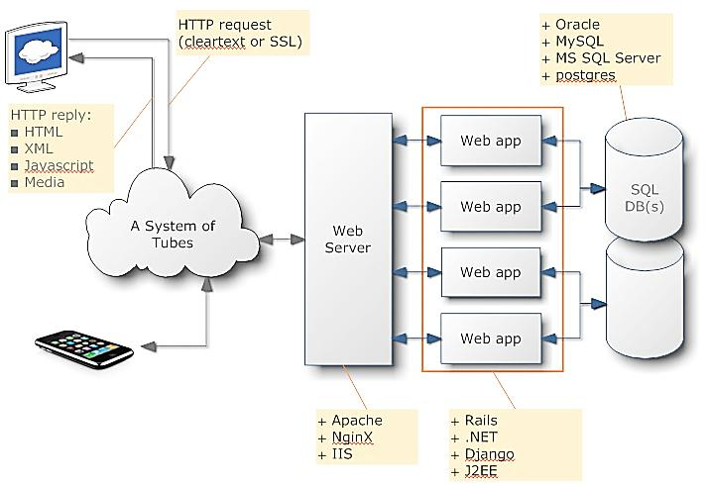

Slide 4
Web application layers
A web application can be divided into three layers
Presentation
Business Logic
Data
Views UI
Logic Code
Database

Slide 5
Web application Tiers
1. Single Tier
In single tier all the three layers (Presentation, business and data) are integrated and installed on single computer. If this application has to be accessed on multiple systems, different installation on separate system needed.

Slide 6
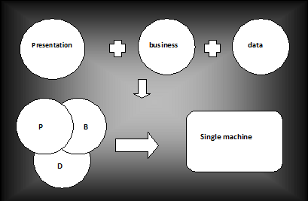

Slide 7
Web application Tiers
2. Two tier
In two tier architecture three layers are distributed on two systems Client and server. Presentation layer resides on client side. Data layer resides on server side. Business logic layer resides on either client side or server side.

Slide 8
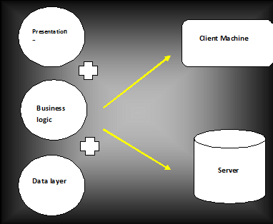

Slide 9
Web application Tiers
3. Three tier
In two tier architecture three layers are distributed on two systems Client and server. Presentation layer resides on client side. Data layer resides on server side. Business logic layer resides on either client side or server side.

Slide 10
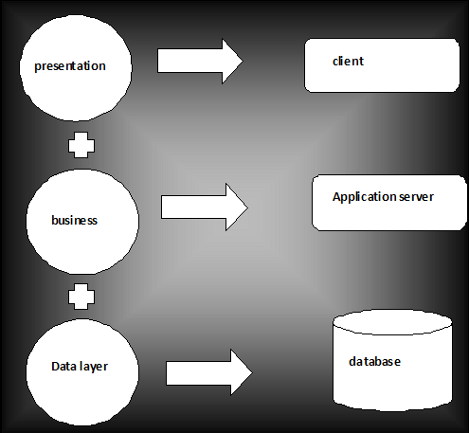

Slide 11
MVC Model
MVC stands for Model-View-Controller. It is a standard in web application design in today’s scenario.
The Model View Controller model is the latest application development model for developing desktop, mobile, and web applications. It is extremely useful in large applications because in MVC, different parts (views, business logic and data storage) of a system are developed separately.

Slide 12
MVC Model - Advantages
It is a simple solution for most web applications.
It is flexible and extensible.
It supports advance application.
It is best to manage application workflow.
MVC model separate the code into three categories: Presentation, Business logic and Data access.
Presentation code can be consolidated in one part of application, business logic in another and the data access in another one.
It is the best suited model, if there is more than one developer working on the same application.
Easy to test and maintenance

